Slide 1

DX University
Visalia California – 2015

Slide 2

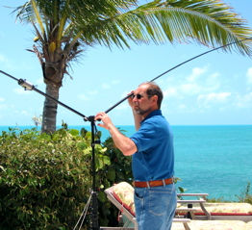
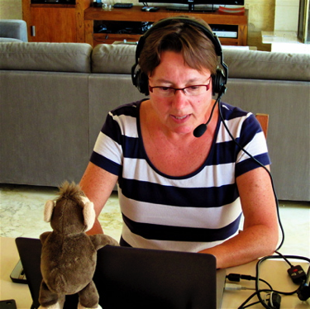
Learn to be a DXpeditioner
Rich KE1B
Anna W6NN
On a Holiday DXpedition

Slide 3
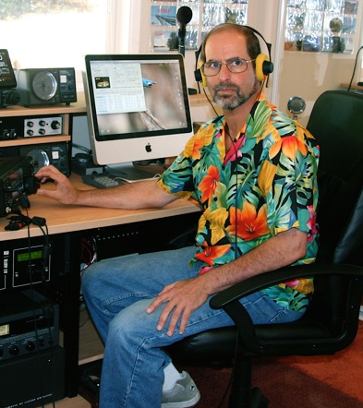
Rich Seifert KE1B
Rich Seifert (KE1B) was first licensed as WN2DLJ in 1968 in NYC. Obtained Extra Class license in 1970.
After moving to Massachusetts and changing his call to KE1B, went QRT from 1982-2007.
Primarily a DX’er and contester, over the past 4 years, he and Anna W6NN have raised “Holiday DXpeditioning” to an art form.
Calls: KE1B, PJ2/KE1B, VP5/KE1B, VP2EAQ, V25M, EA8/KE1B, 9H3MMM, J38MM and of course, K6MMM

Slide 4
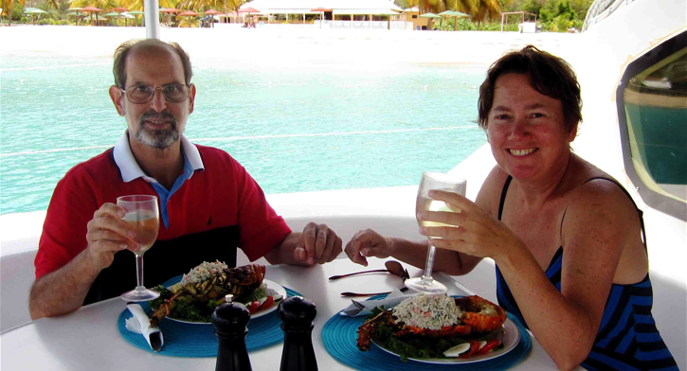
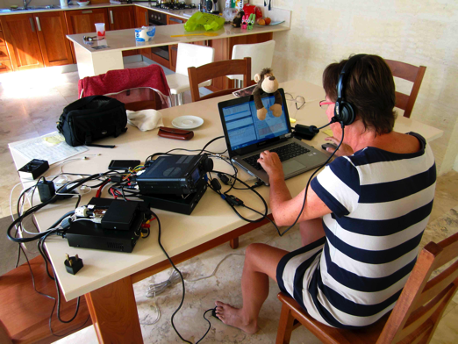
Both the Holiday and the DX are important
Holiday DXpeditions, Rich Seifert KE1B

Slide 5

Clublog Top 40
We’re Not Going to ANY of these places!
Holiday DXpeditions, Rich Seifert KE1B

Slide 6
The Caribbean has Lots of Great Choices
Holiday DXpeditions, Rich Seifert KE1B

Slide 7
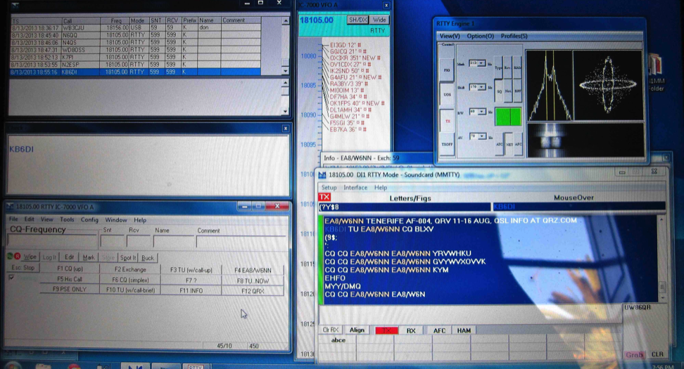
Full Computer Control and Logging
• All Modes: CW, SSB, RTTY, PSK
• Macro Function Keys for CW and Digital Modes
• Cluster Access via WiFi (Can see when spotted, and comments)
• Real-time log upload to ClubLog (very slick)
Holiday DXpeditions, Rich Seifert KE1B

Slide 8
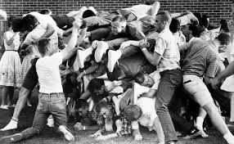
How to Generate a Pileup
Go someplace relatively rare
Pre-announce your trip
Use obscure Band/Mode Slots
Spotting
Be aware of propagation

Slide 9
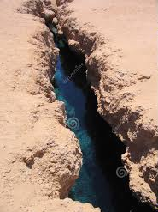
To Split, or not to Split
Split Benefits the Pileup, Not the Operator
Can start simplex, then go split when the pile appears
Be prepared to go either way
Set up the radio for instant change
(I’ll show you how)
Check the listening frequency first!

Slide 10

For N1MM users
+n Ctrl-Enter will go split, with offset n kHz up
(However, this is the DX’er split, transmitting up)
Alt-F10 will swap VFOs (this is the DXpeditioner split, listening up
DXpedition Mode:
Alt-F11 will lock you in Run mode even if frequency changes

Slide 11
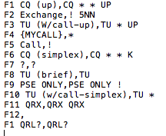
My CW Macros
Note: {SENTRST} defaults to
599, but allows you to send real
signal reports if you wish
Helpful when the pileup is ignoring your request

Slide 12
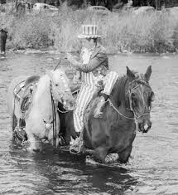
Operating Tips
Stations will “naturally” spread out, particularly on CW/RTTY
Know and use your radio’s filtering capability: IF and AF
Work the edges if the pileup is too massive to handle
Once you pick a station, stay with him
never, Never, NEVER change horses in mid-stream
If necessary, thin the herd geographically
(EU, NA, JA, etc.)
At worst, “go by the numbers” (SSB only)
(And never allow an interloper)

Slide 13
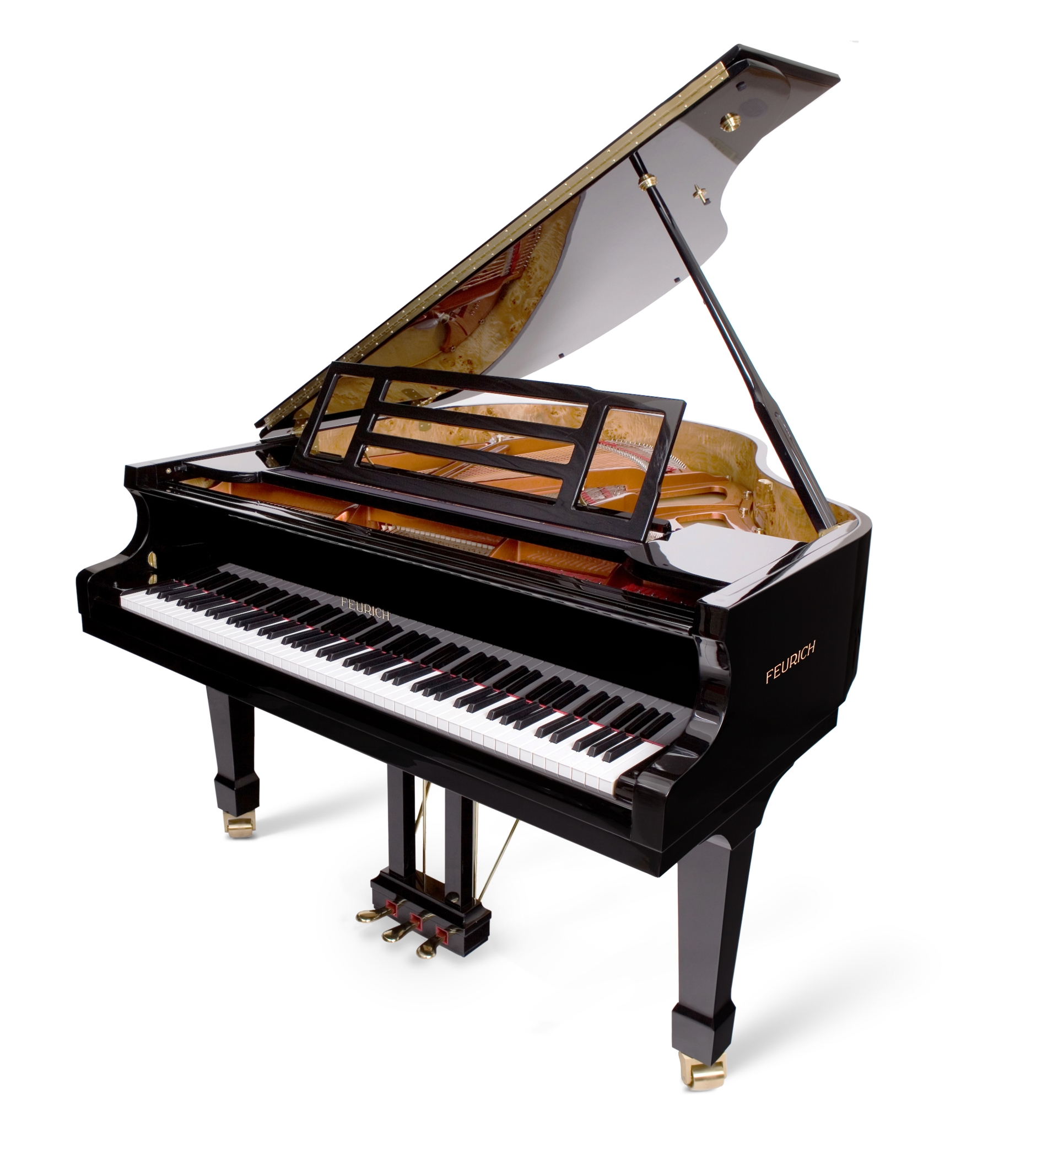
How do you get to Carnegie Hall?
Practice, Practice, Practice!
Morse Runner is “ok” (Meh.)
Best practice is to operate in contests
  CQP generates pileups for even small CA stations
  Join a multi-op at a superstation
  Do a special event operation (e.g., W1AW/6)
Work at whatever speed you are comfortable

Slide 14
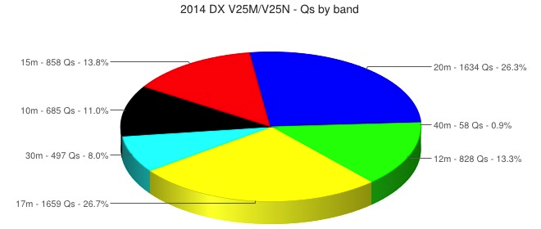
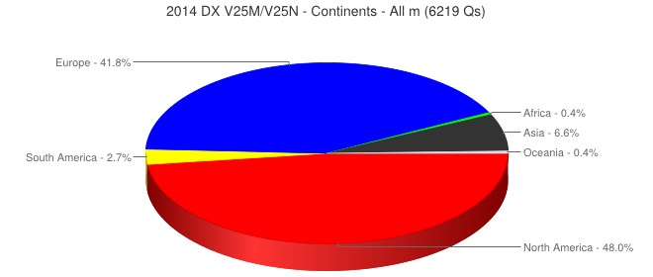
V25M/V25N Antigua 2014
Holiday DXpeditions, Rich Seifert KE1B

Slide 15

It’s All About the Attitude!
Holiday DXpeditions, Rich Seifert KE1B

